Slide 1
Close Proximity Electric Induction Data Transfer
Ecma/TC50/2011/005

Slide 2
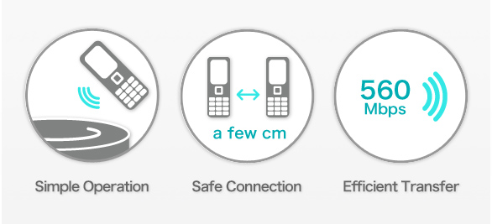
Electric Induction Coupling
Electric induction is a mode of wireless field propagation that operates only for short distances up to a few centimeters. By taking advantage of this characteristic in combination with a very low transmission power, it is possible to create a wireless system optimized for close proximity communications and data transfer. From a usage standpoint, the system can be implemented as an touch-activated, high-speed coupling interface providing instant connectivity between two active electronic devices.

Slide 3
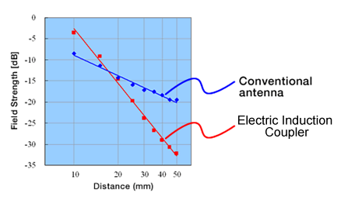
Induction vs. Radiation
  A specially designed antenna called a coupler is used to maximize the longitudinal electric
  induction component and minimize the radiation component of the wireless energy. This results in highly efficient coupling in the near field while providing sharp attenuation in the far field.
Electric Induction
Coupling Mode
Longitudinal
Component
Transverse
Component
Induction
Plate
Inductive
Charge
Resonant
Stub
+ + + + +
L
Quasi-Static
_ _ _ _ _
Induction
Inverse
Mirror Charge
Radiation
Ground
Conventional Wireless
TEM Mode

Slide 4
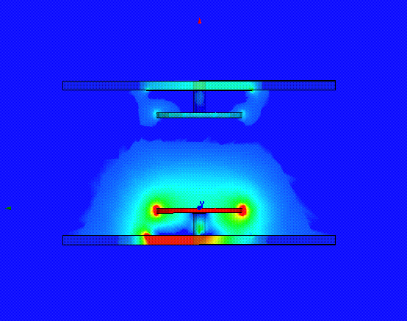
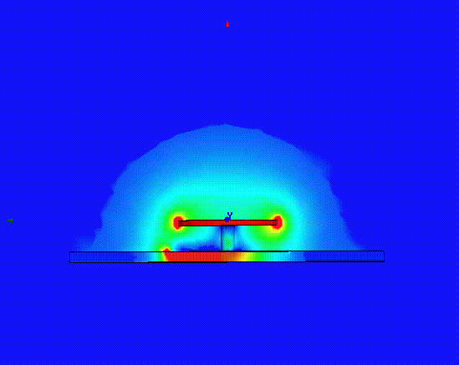
Coupling Animation
  The coupler delivers a "bubble" of energy which collapses back in its entirety with each cycle, unless another coupler comes into its vicinity in which case part of the energy is absorbed by this target coupler. When there are no target couplers nearby, no energy is dissipated (there is no loss) unlike traditional antennas radiating TEM waves.
λ/ 2 @ 4.48GHz
Coupler
1cm
No Target
Target within range
Rue du Rhône 114 - CH-1204 Geneva - T: +41 22 849 6000 - F: +41 22 849 6001 - www.ecma-international.org 4

Slide 5
Polarization and Sensitivity
Conventional Radiating Dipole Antenna
Linear Polarization
  Because the longitudinal electric induction fields originate from a single plate, they are not polarized. The couplers can approach each other at any angle without sacrificing coupling performance, in contrast to
  radiating antennas which generally have clear polarizing characteristics.
  The near-field sensitivity is also higher using couplers compared to traditional dipole antennas.
  Only electric induction couplers are used as antenna elements for Close Proximity Electric Induction Data Transfer.
Longitudinal Electric Induction Coupler
Polarization Free

Slide 6
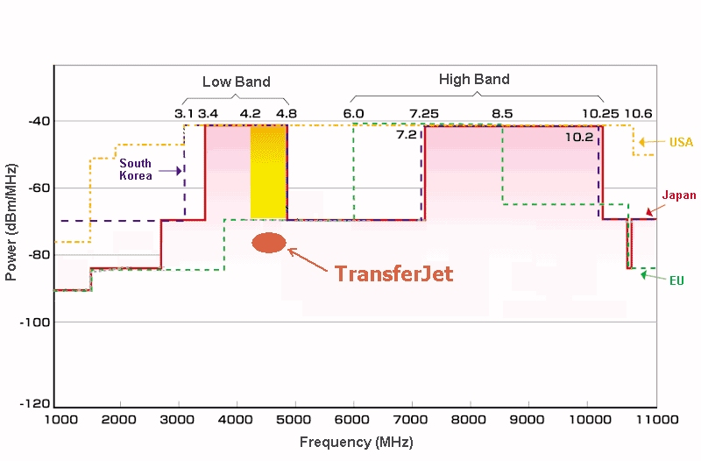
Regulatory Compliance
  The frequency used is from 4.2 to 4.76 GHz, corresponding to a narrow section of the UWB band available in most regions of the world. The power level is kept at or below -70 dBm/MHz, which means that a compliant device will be DAA exempt.
-41.3 dBm/MHz:
China
-70 dBm/MHz:
TransferJet
Region of Operation
4.2 to 4.76 GHz
-70 dBm/MHz or below
Example of Regional Regulatory Restrictions

Slide 7
International Standardization
  Major global consumer electronics vendors and technology/service providers are considering deployment of products on an international scale. The establishment of these specifications as international standards is very important to ensure that products and systems interoperate seamlessly and deliver the intended user experience.
  Regulatory compliance has been confirmed for most of the major countries and regions of the world, which will allow rapid market deployment of products and applications across different regulatory domains.

Slide 8
Basic Specifications
Center Frequency | 4.48 GHz
Bandwidth | 560 MHz
Transmission Power | < -70 dBm/MHz
Transmission Rate | 560 Mbps (physical layer）
Modulation | Direct Sequence Spread Spectrum (DSSS)
Communication Distance | Up to a few centimeters
Data Transfer Direction | Bi-directional, symmetric
Antenna Element | Electric Induction Coupler
Connection Topology | 1-to-1, Point-to-Point
_

Slide 9
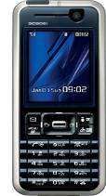

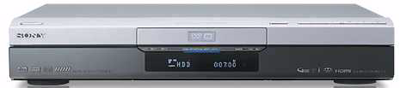

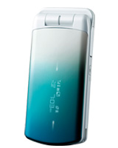

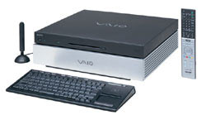
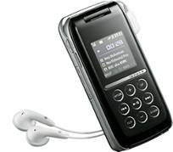
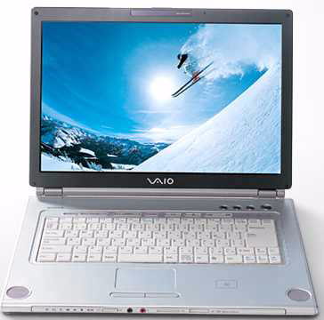
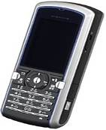
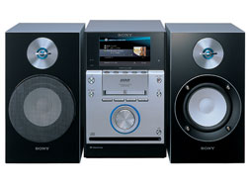
Creating a New High-Speed Touch Paradigm
Worlds are About to Touch

Slide 10

Rue du Rhône 114
CH-1204 Geneva
T: +41 22 849 6000
F: +41 22 849 6001
www.ecma-international.org

